Slide 1

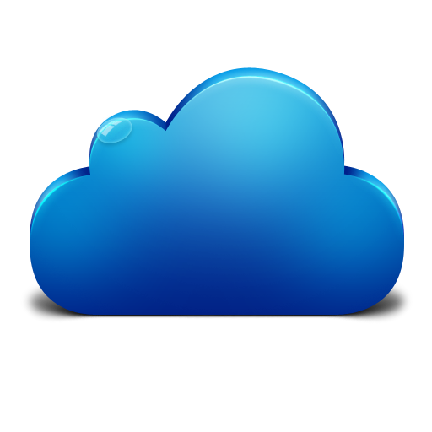
EMC Underground: MetroLabs
MetroLabs

Slide 2
Who We Are – Core SEs
Jason Delosrios
James Domino
John Gunther
Kevin Kobilinski

Slide 3
Goal
The goal of this series of labs is to provide a hands on experience in developing a Continuous Integration/Delivery pipeline to deploy an apache web server with content to serve up through the web server.
The tools used in this lab series will be:
Github
Jenkins
Puppet
Docker

Slide 4
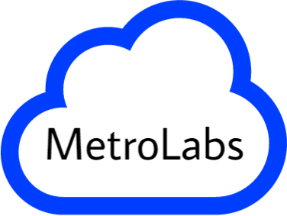
Survey Results

Slide 5
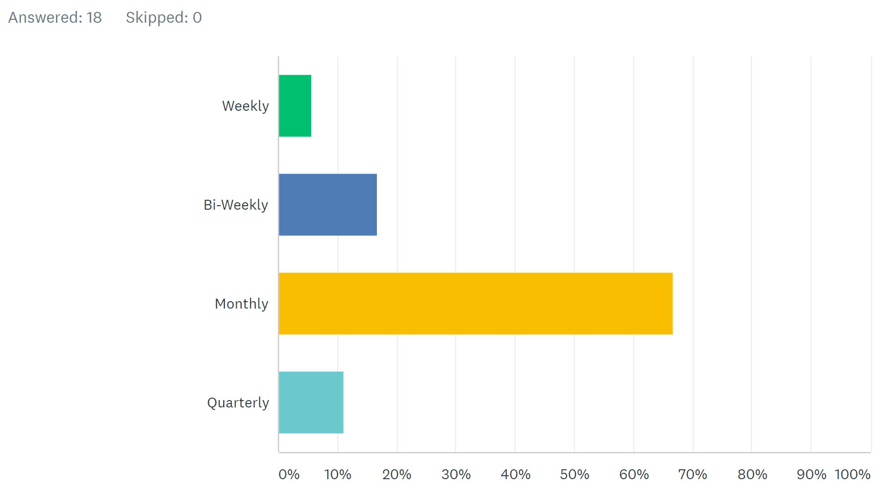
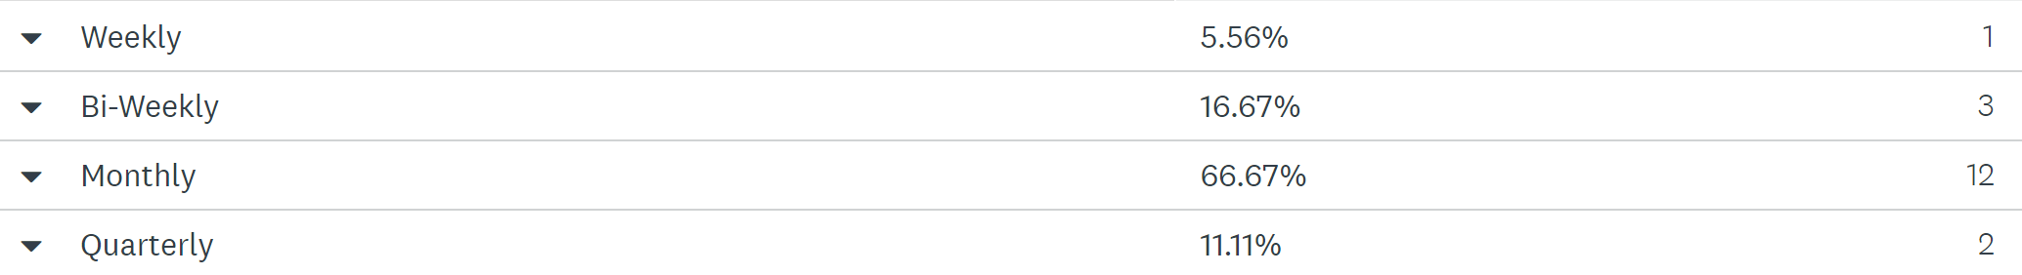
How Frequently would you like to meet up

Slide 6
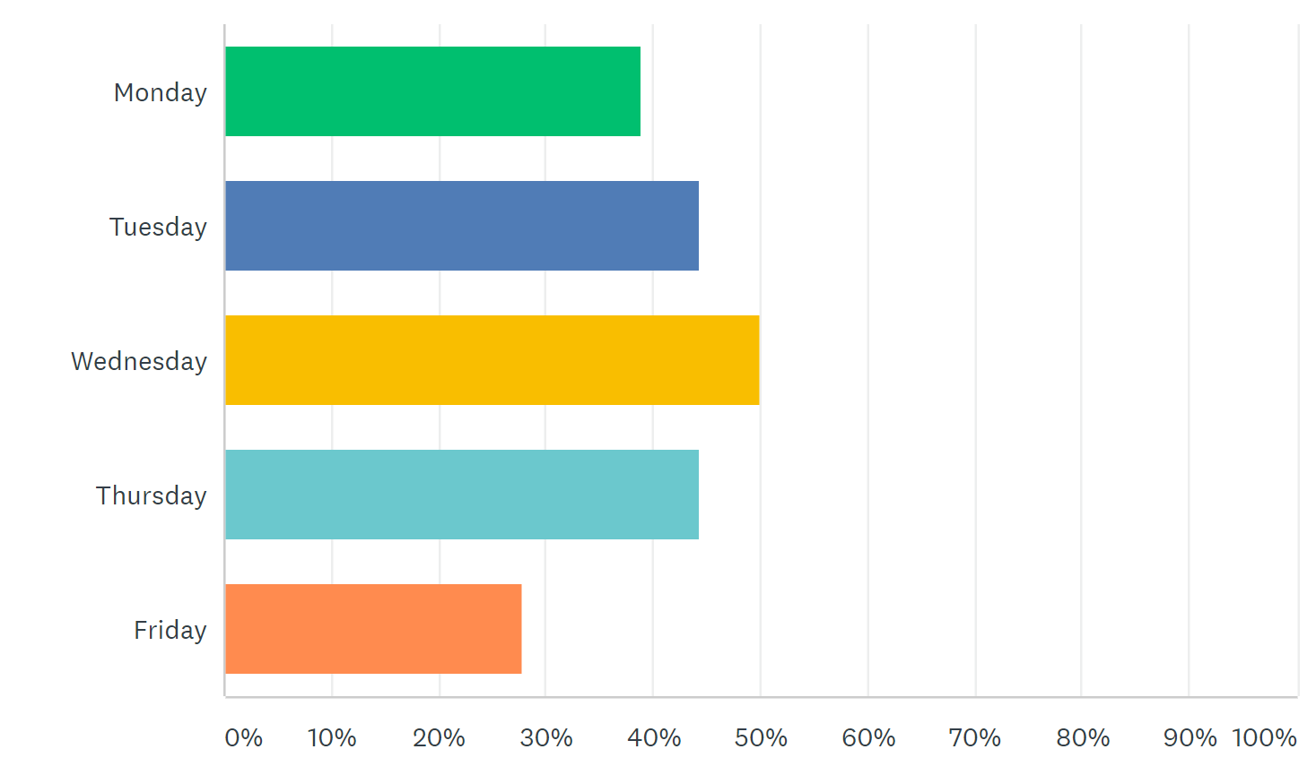
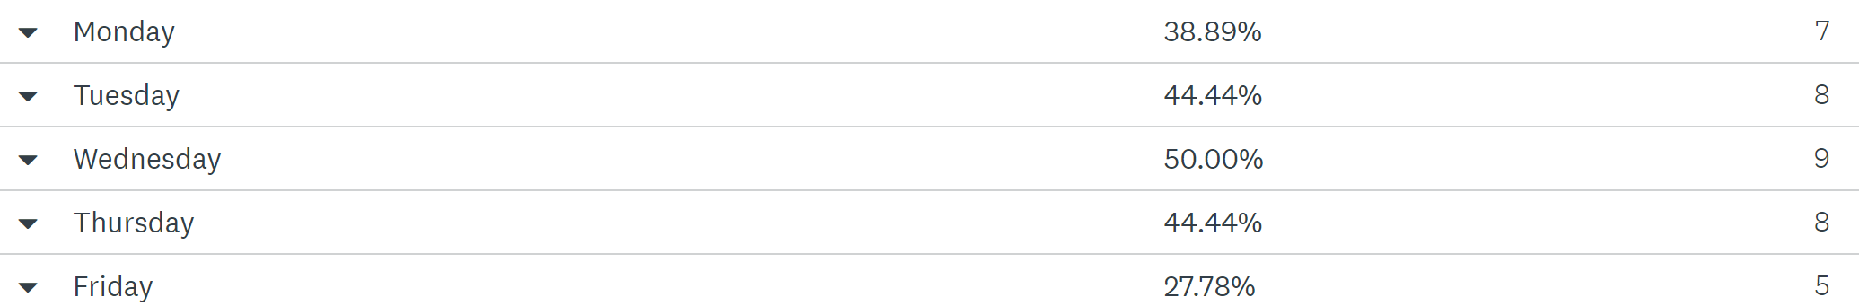
What day(s) of the week work best for these meetings?

Slide 7
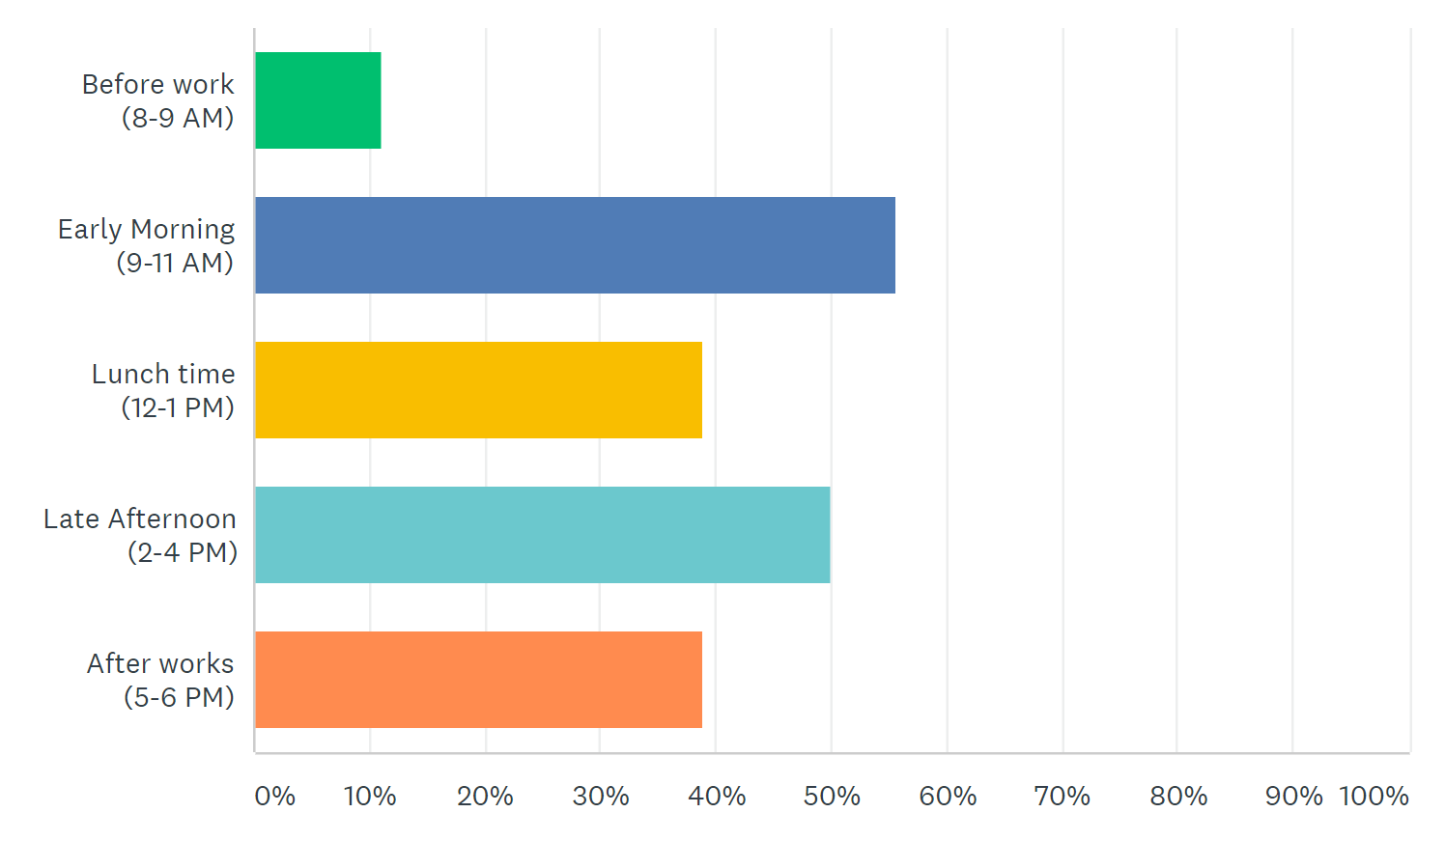
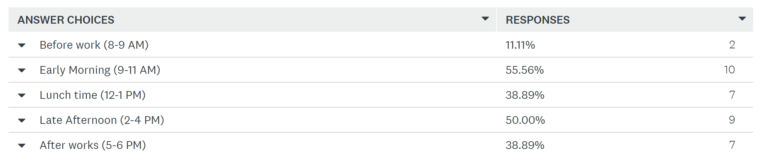
What time works best?

Slide 8
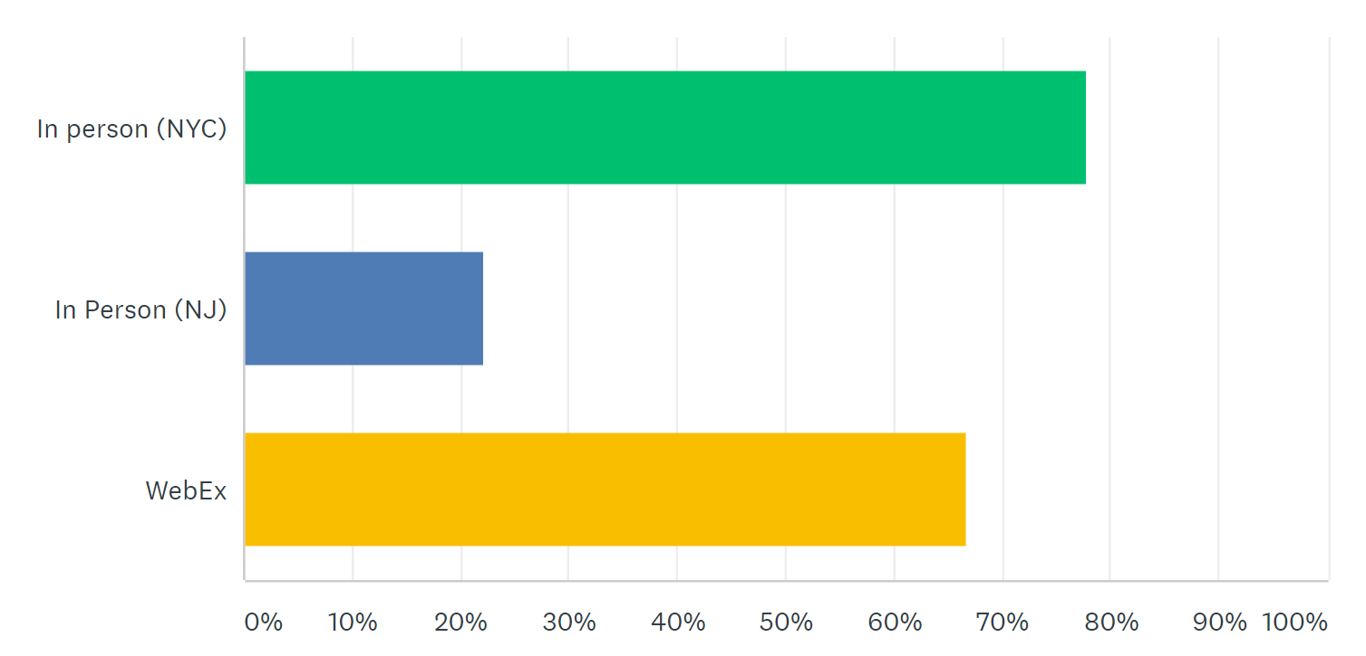
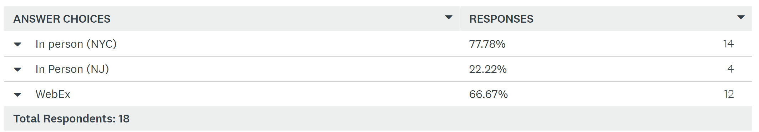
How would you like to attend?

Slide 9
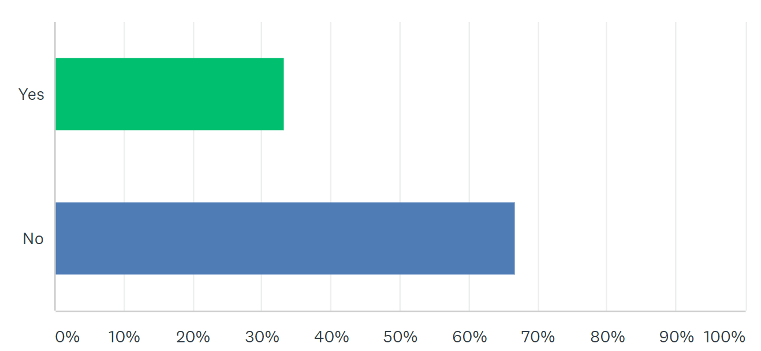
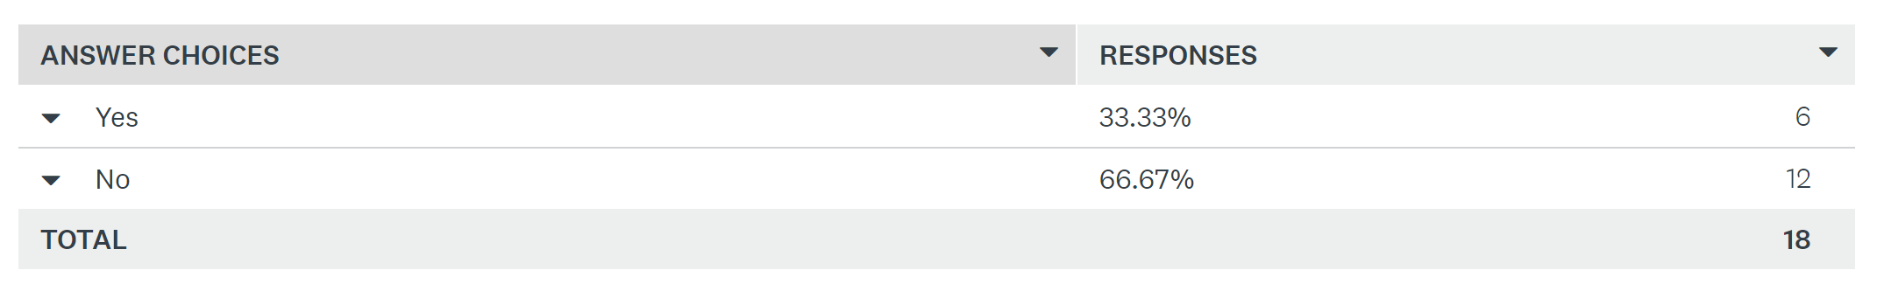
Do you have DevOps Experience?

Slide 10
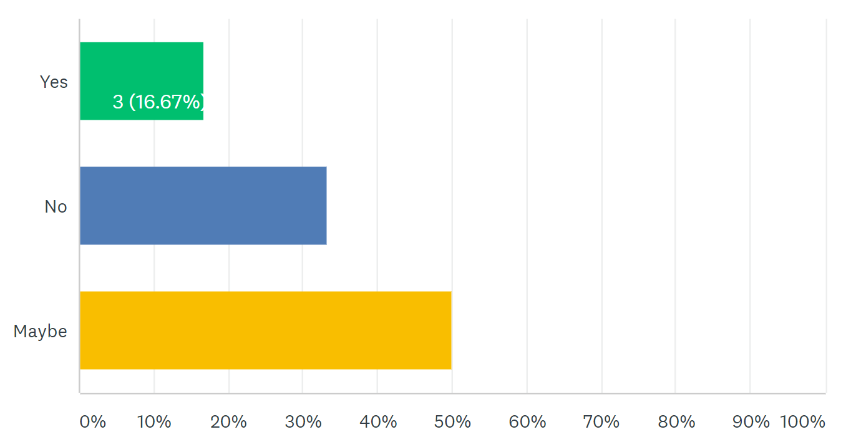
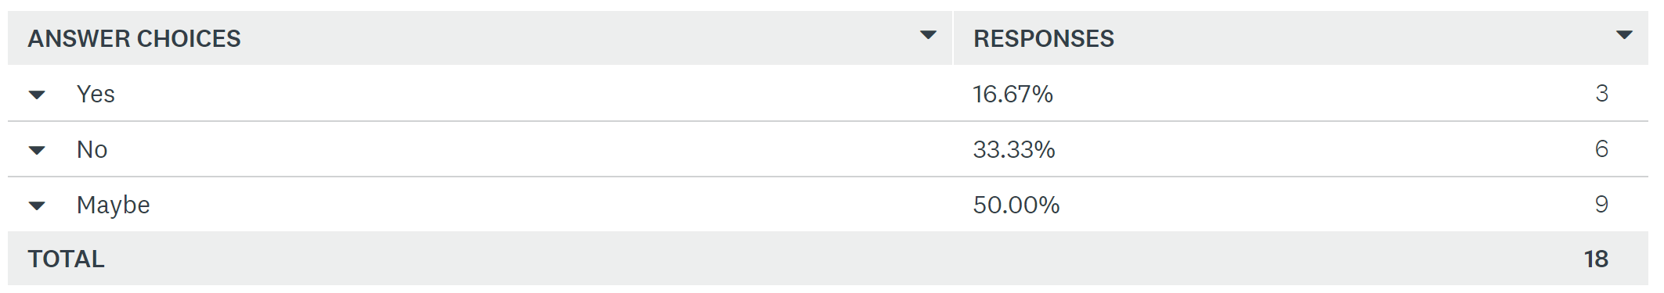
Are you interested in assisting MetroLabs?

Slide 11
A little history on how we got to be where we are today

Slide 12
Application

Slide 13

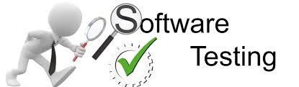

Traditional Development Process
Testing Planning
Test
Execution
Requirements
Gathering
&
Analysis
Business Need
Deployment
Maintain
Design
Construction

Slide 14
Why Change was Needed?
Groups worked in isolation, no collaboration and communication with the business folks
Work performed sequentially
Inflexible to change to business requirements
Difficult to go back to a previous phase of the development cycle
Testing is conducted when the whole project is done
Functionality is not observed till the testing is being conducted
Issues and misinterpretation of requirements are not found till the end
Modification/changes is costly and time consuming
Operation is not included with any decisions during the entire development life cycle, however, have to support what was given to them in the end

Slide 15
Answer – Agile Development
An alternative to the traditional development life cycle.
Development approach that provides opportunities to assess the direction of a project throughout the development lifecycle.
An approach affording the ability to respond to unpredictability through incremental, iterative work cadences and empirical feedback.
Through regular cadences of work, known as sprints or iterations, the teams must present a potentially shippable product increment addressing a business need.
Scrum is one of the more popular ways of introducing Agile development to an organization
Scrum consist of
Roles: Product Owner, Team, and Scrum Master
Scrum has five meetings: Backlog Grooming (aka Backlog Refinement), Sprint Planning, Daily Scrum (aka 15-minute standup), the Sprint Review Meeting, and the Sprint Retrospective Meeting.

Slide 16
Sprint?
Is the basic unit of development in Scrum.
Is a time boxed effort; that is, it is restricted to a specific duration.
The duration is fixed in advance
Each sprint is normally between one week and one month, with two weeks being the most common.
Teams use inspection throughout the project to ensure that the team meets the goals of each part of the process.
Each sprint into its own list of requirements.
The development team builds and tests a functional part of the product until the product owner accepts it and the functionality becomes a potentially shippable product.
When one sprint finishes, another sprint starts.
Scrum teams deliver product features in increments at the end of each sprint. A product release occurs at the end of a sprint or after several sprints.

Slide 17
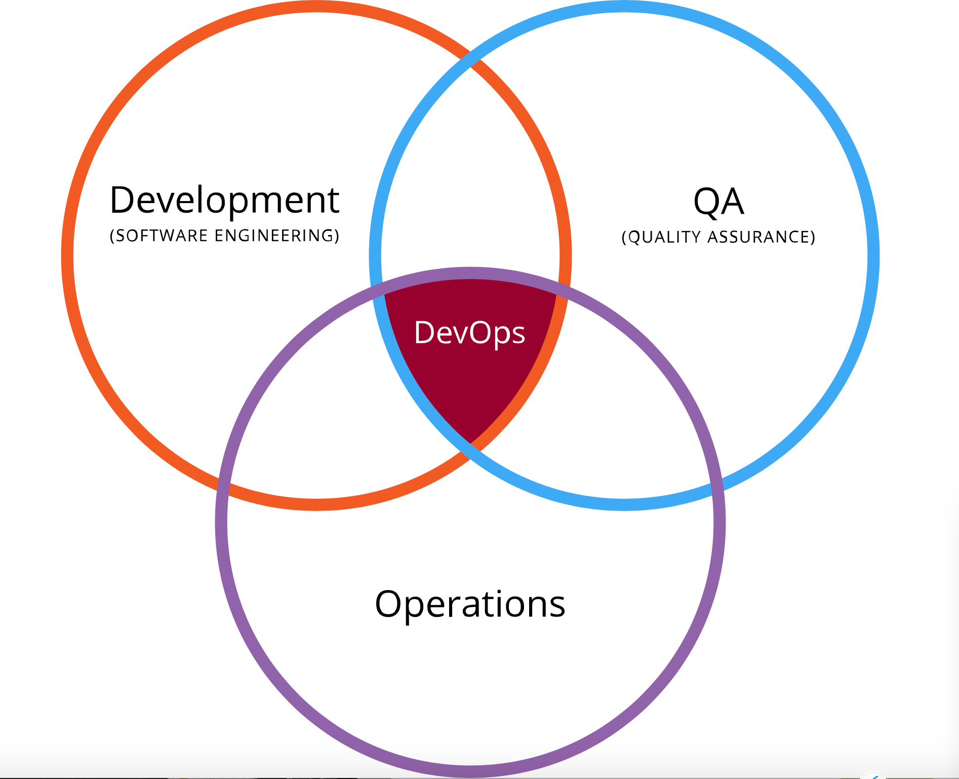
What is a team?
DevOps (Development & Operations)
Development, Operations, Test and BUs working together

Slide 18
Why DevOps

Slide 19
Continuous Integration/Delivery

Slide 20
Infrastructure

Slide 21
Journey of Instances
Prior to 2000
Physical Servers
2000-2013
Physical Servers
Prior to 2000
Physical Servers ()
Virtual Machine (VMs)
2000-2013
Move to Virtual Machines
2013-
Physical Servers
Physical/VM-
Physical/VM
Virtual Machine (VMs)
Container
Container
Container
Container
Containers
Container
Container
What’s Next?
We have more ways of providing infrastructure
Notes:
But first we need to set the stage around containers , our current GTM, and the cloud ecosystem. We do this through a discussion on instantiation , and the instances we provide to app-dev.
Many years ago when we started our journey in distributed IT we delivered physical servers to our customers
[click]
Then a bit before 2000, advancements in processor and memory density started accelerating, and along with Moore's Law, forced the industry to partition servers and drive consolidation ratios through virtualization
[click]
Virtual machines were then added to what types of instances we can deliver.
These instances starting forming a sort of “contract” with applications owners and developers. Its how dev and ops interacts with each other.
In fact how many have we seen a conflict btw devs and ops over vCPU assignments in VMs because VM sizing was one of the key ways dev and ops would communicate
[click]
Fast forward to today and now you not only have physical servers and VMs as instance types
[click]
But you now have containers to support
[click]
and in some cases , like in Pivotal Cloud Foundry or server-less technologies…You have just code artifacts being deployed, and the contract is not a VM or a container
[click]
We live in a time where we have many more ways of providing infra to developers or application owners , and this requires us to think about the different platforms and solutions support these instances.

Slide 22
How Does this help You!

Slide 23
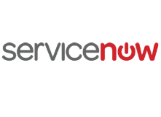

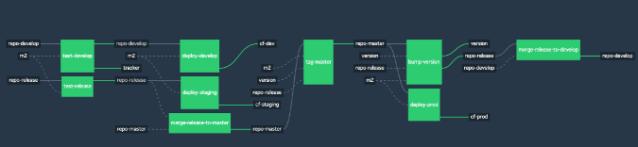
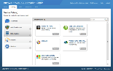
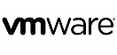


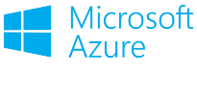

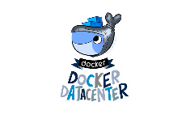
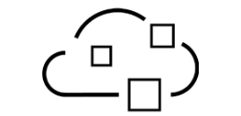
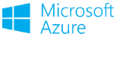
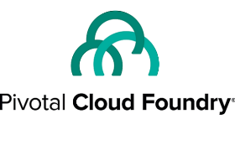
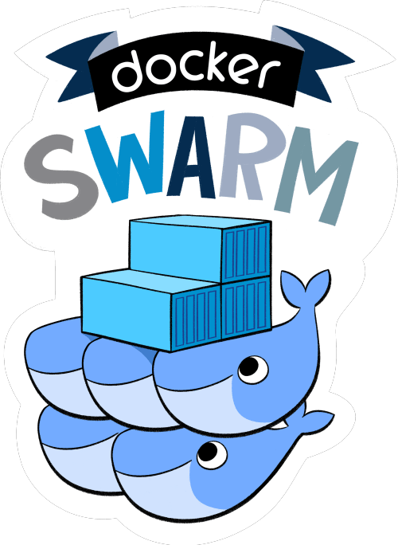
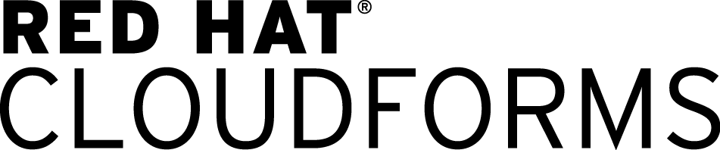

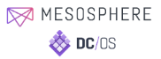
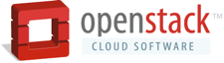
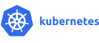


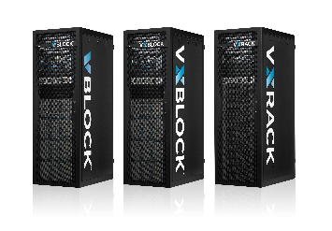
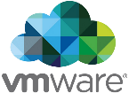

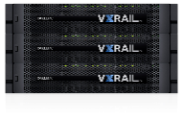
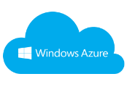

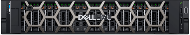

Deploying VMs
Deploying Containers
Deploying Code
Portals
Scripting
CI/CD Pipeline
Instantiation
vRealize Suite
VM CMPs
DIY Container
M&O
Commercial
PaaS and CaaS Suites
Platforms
Platforms
vRealize Suite
On-premises
Off-Premises
Compute/Capacity
Servers
HCI
Ready Solutions
Standardized
Specialized
Notes:
Why bc it all needs Infrastructure, off=premises and on-premises
and while a few customers are looking off-premise for these instances a large majority will need on-prem infra
[click]

Slide 24
Deploying VMs
Deploying Containers
Deploying Code
Portals
Scripting
CI/CD Pipeline
Instantiation
vRealize Suite
VM CMPs
DIY Container
M&O
Commercial
PaaS and CaaS Suites
Buy an XaaS Engineered Solution for Traditional Apps
Buy an Cloud Agnostic PaaS
for Cloud Native and Java Apps
Platforms
Platforms
vRealize Suite
Dell EMC has most uses cases covered with bookend turnkey solutions – vRA/EHC for XaaS and PCF/NHC Cloud Native
On-premises
Off-Premises
Compute/Capacity
Servers
HCI
Ready Systems
Standardized
Specialized
Notes:
We have done a great job of positioning solution on both bookends of this continuum
On the left side delivering Vmware vRealize Suite for VM based portals , and delivering to customers a turnkey solution in XaaS with EHC

Slide 25
Deploying VMs
Deploying Containers
Deploying Code
Portals
Scripting
CI/CD Pipeline
Instantiation
vRealize Suite
VM CMPs
DIY Container
M&O
Commercial
PaaS and CaaS Suites
Platforms
Platforms
vRealize Suite
However your customers may be deploying in the “Messy Middle”
A place of continuous change, new products and solutions, and most of all OPPORTUNITY
On-premises
Off-Premises
Compute/Capacity
Servers
HCI
Ready Systems
Standardized
Specialized
Notes:
However vRealize and EHC or Pivotal Cloud Foundry (PCF) and Native Hybrid Cloud (NHC) may not resonate with you customers. Or maybe your customer has a partnership with a HP or IBM. Maybe they already have some technical debt in one of these platforms. Your customers may be deploying in what we call the “Messy Middle” - A place of continuous change, new products and solutions, and most of all OPPORTUNITY….. Why opportunity?

Slide 26
Deploying VMs
Deploying Containers
Deploying Code
Portals
Scripting
CI/CD Pipeline
Instantiation
It all needs infrastructure!
vRealize Suite
VM CMPs
DIY Container
M&O
Commercial
PaaS and CaaS Suites
Platforms
Platforms
vRealize Suite
On-premises
Off-Premises
Compute/Capacity
Servers
HCI
Ready Solutions
Standardized
Specialized
Notes:
Why bc it all needs Infrastructure, off=premises and on-premises
and while a few customers are looking off-premise for these instances a large majority will need on-prem infra
[click]

Slide 27
Containers

Slide 28
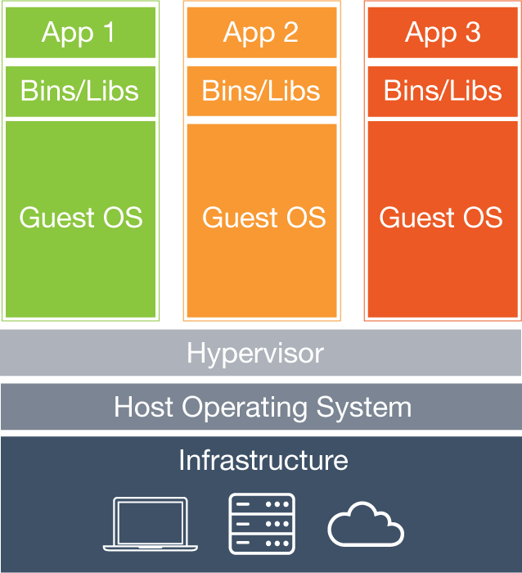
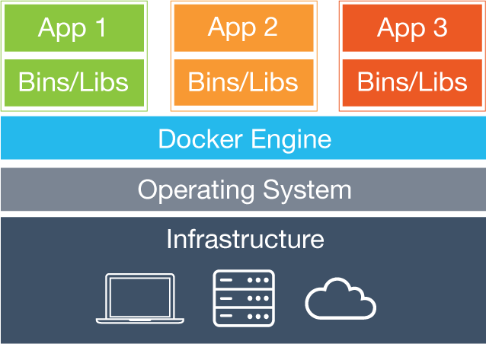
Containers vs VMs
Deploying VMs
Deploying Containers
Traditional cloud instance with broadest adoption and platforms
Requires full OS
Next gen cloud instance
Shared Kernel
Super fast instantiation
Very portable
VM
container
Hypervisor
Container Engine
Notes:
Best way to explain containers is to compare to something we know and hold dear – Virtual machines
VMs are just a mirror image of a server – virtualization creates a mirror image of a server
That means you have a full OS
Think about what that OS does – translate HW to an App and APP to HW
And with utilization rates for VMs averaging 20-50% in most companies
Now think about all the VMs running in a typical enterprise -100’s maybe 1000’s of VMs – all with there own OS
VMs are not going away – they still needed for a lot of reasons
Some apps wont be put into containers
Some apps only run on VMs , ISVs
Like the other critical heritage environments – Mainframes for instances – VMs will still be needed
Right now the industry is heavy into the debate on whether things like Oracle DBs should be put into containers – sound familiar?

Slide 29
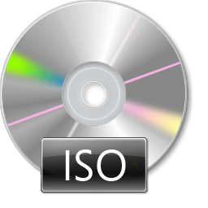

Another way to think about it…
Deploying VMs
Deploying Containers
100’s MBs – X GBs
MBs – 100s MBs
Notes:
Here is another way to look at the differences – ISO image vs ZIP file
VMs are like ISO images – they have everything they need to boot a server image and run an OS and applications, you can apply an ISO to a bare metal server to build a full server
Containers are like zip images , zips are just a package of files and maybe applications, you cant install a ZIP file on a bare metal server – you need an OS plus some other things.

Slide 30
Linux containers are built on…
Linux Containers
namespaces
cgroups
SELinux / AppArmor
Purpose | Isolates and virtualizes processes | Limits and accounts for resources | access control security policies and profiles
Initial Release | 2002 (15 yrs.. ago) | 2007 (10 yrs. ago) | 1998 (19 yrs. ago)
… and have been around for over 10 years.
Notes:
Containers originated form the UNIX/Linux world
Containers in Linux are made possible by a few key features built into the Lunix kernel that isolate processes and limit resources.
The actual purpose of each component is not that important
What is important is how long these components have been around , one almost 20yrs !!!
So the questions one would ask is , Why are we taking about containers now?
So in the last few years , people have tried to leverage Linux containers and develop different approaches to tools
[click]

Slide 31
Plethora of tools to choose from

Slide 32
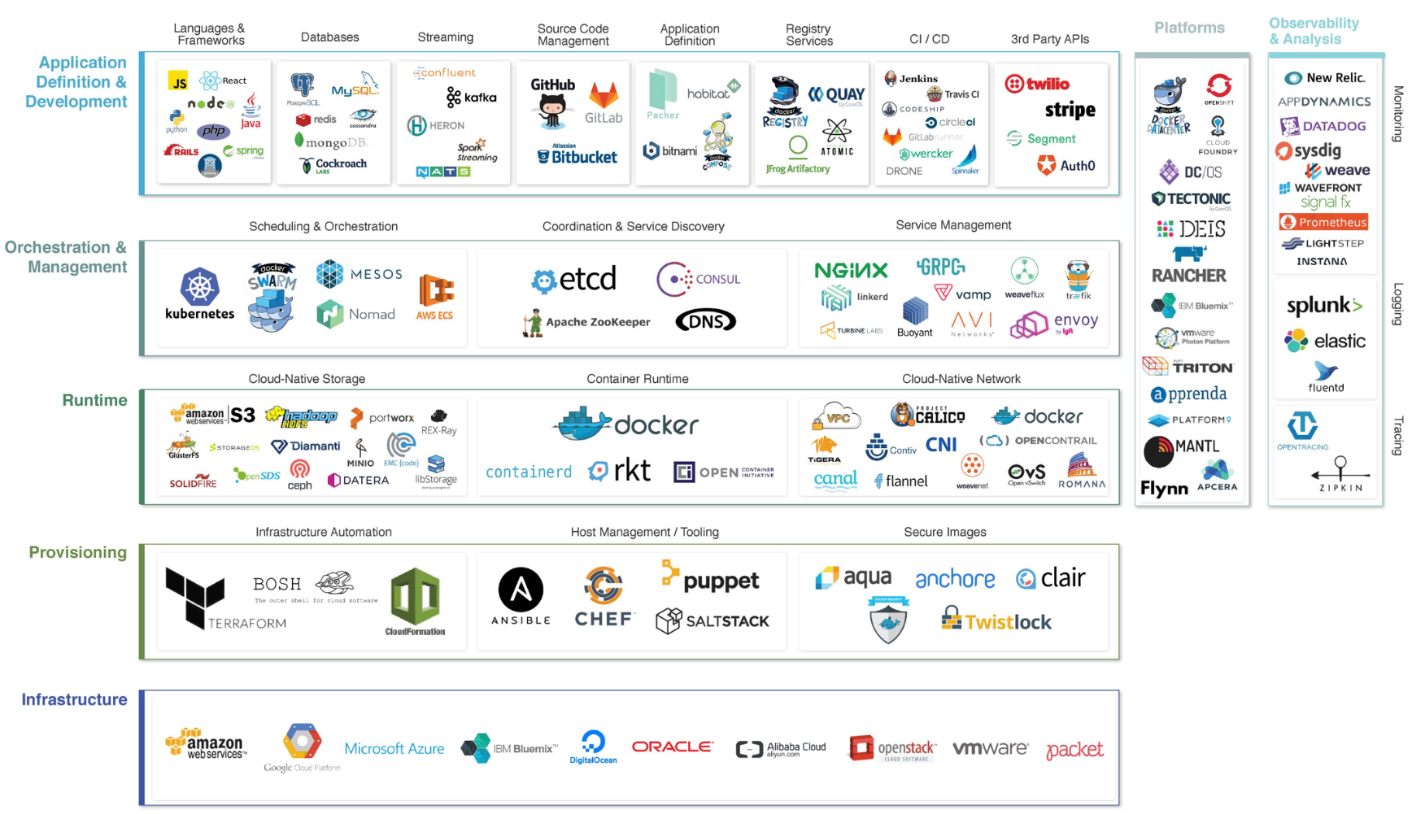
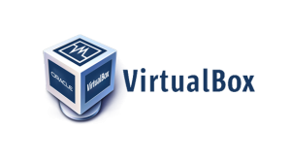
THE CLOUD NATIVE LANDSCAPE
*From Cloud Native Computing Foundation (CNCF)

Slide 33
The Project

Slide 34

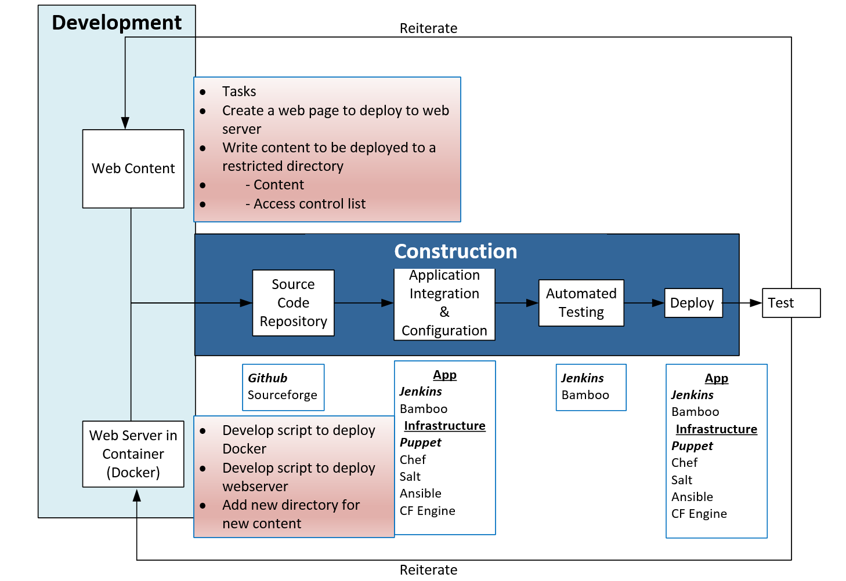

Slide 35
Questions?

Slide 36
Lets Get Started

Slide 38
THE CLOUD NATIVE LANDSCAPE
*From Cloud Native Computing Foundation (CNCF)

Slide 39
Deploying VMs
Deploying Containers
Deploying Code
Portals
Scripting
CI/CD Pipeline
Instantiation
vRealize Suite
VM CMPs
DIY Container
M&O
Commercial
PaaS and CaaS Suites
Platforms
Platforms
vRealize Suite
This is the continuum of cloud platforms customers would consider to support the management and orchestration of instances.
On-premises
Off-Premises
Compute/Capacity
Servers
HCI
Ready Systems
Standardized
Specialized
Notes:
The next layer is the platform layer – or the continuum of cloud platforms that customers would consider to support the management and orchestration of instances. We organize this layer into 3 major buckets.
On the left side you have your virtual machine cloud management platforms like VMware’s vRealize or our turnkey vRA solution Enterprise Hybrid Cloud (EHC). Note there is also Azure / Azure Pack, RedHat CloudForms, and Cisco UCS Director being used by our customers to deploy VMs.
In the middle you have the Do-it-yourself (DIY) container Management and Orchestration (M&O) solutions -
On the right side are the cross-cloud PaaS Suites that are mostly container based but can be VM based.
Hyper-V, KVM and VMware ESXi/vSphere were excluded as they are infrastructure cluster managers and hypervisors – not to minimize their importance – but to stress that the focus on platform orchestration.
One word of caution, This is not meant to be a decoder ring , read strictly from top to bottom. We all know that customers environments are all slightly different. This is meant as simple way to describe what I happening in the cloud solutions ecosystem and drive a discovery discussion with customers.

Slide 40
Why Agile?
Agile development methodology provides opportunities to assess the direction of a project throughout the development lifecycle
How?
Through regular cadences of work, known as sprints or iterations, at the end of which teams must present a potentially shippable product increment

Slide 41
Deploying Containers
DIY Container
M&O
Commercial
PaaS and CaaS Suites
On-premises
Servers
HCI
Ready Solutions
Notes:
Today we are going to focus on two areas of opportunity :
The container platforms
And on-premises solutions for these platforms
There is a lot of hype about containers , however to a lot of us it feel like we are at the beginning of a fundamental shift in how infra gets delivered and the interaction btw Ops/Infra and app-dev
To me it feels like I am back in 2004-2007 (mid 2000s) , when VMs were taking off , and you have this great dialog in the industry around what can get virtualized and how to manage VMs at scale, and all these new tools were being developed , new companies were popping up
When I think about containers it takes me back to VMWorld 2006 in or VMWorld 2007 in , those were amazing times when everything seemed so awesome so new and fresh
Lets see what containers are all about….

